Slide 1
Computer Shop Management System
Inventory Management for Computer Stores
By John Marvin S. Miciano
25/11/2024

Slide 2
Introduction
Overview – The system is a web-based application for managing computer inventory.
Objective – To streamline inventory management, reduce manual tasks, and enhance data accuracy.
Key Users – Store staff and administrators.

Slide 3
System Description
Key Functionalities : User Authentication Inventory Management(Add, Edit, Delete) Session Management
Technology Stack : Frontend (HTML, CSS) Backend (PHP, MySQL)

Slide 4
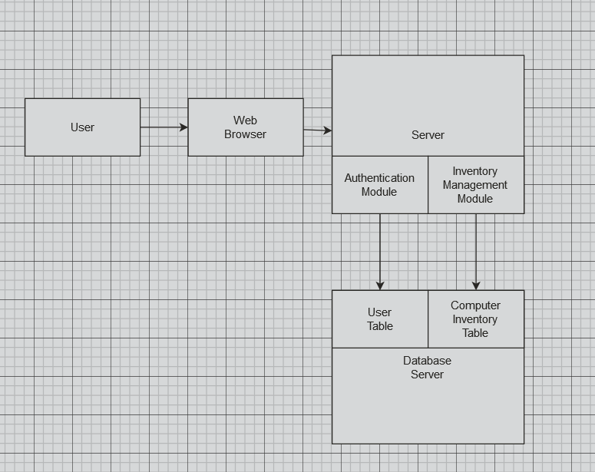
System Architecture
Client Server Model: Client(Web browser) – Used by staff for data entry and retrieval Server(PHP) – Processes requests, manages sessions and handle data validation Database Server(SQL) – Stores user and inventory data
A simple Block Diagram :

Slide 5
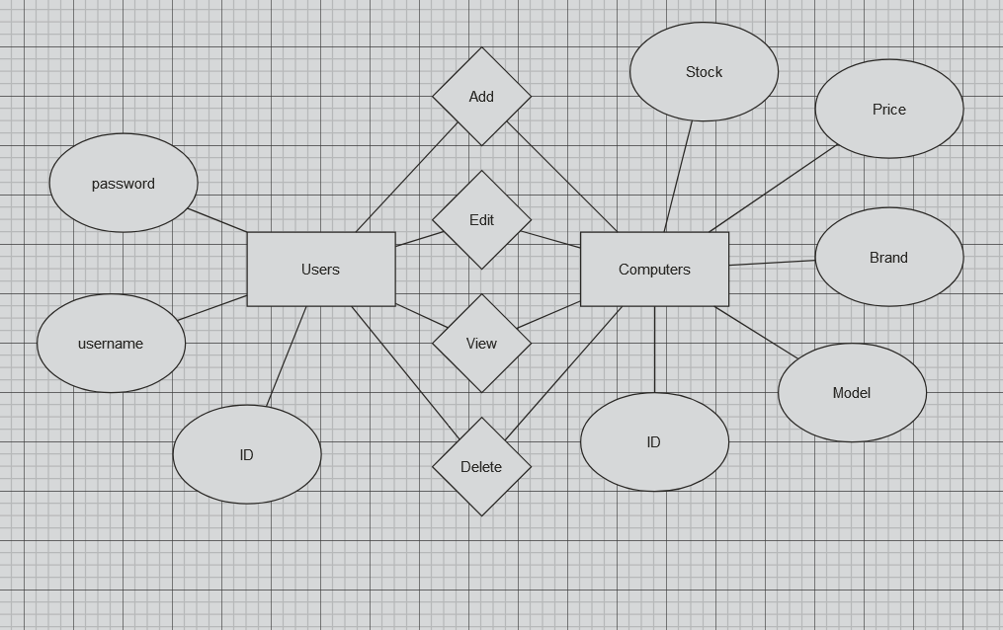
Database Design
User Table – Stores user details (id, username and password)
Computer Inventory Table – Stores computer details (id, model, brand, price, and stock)
ERD of the system :

Slide 6
System Features
User Authentication – Secure login with session management
Inventory Management – CRUD operations for managing computer records
Responsive Design – Website is intuitive on both desktop and mobile devices
Security Measures – Password is hashed , 10 minutes of inactivity destroys the session

Slide 7
Development and Testing
Technologies used : HTML, CSS, PHP for the frontend PHP for the backend logic MySQL for data storage Notepad++, phpMyAdmin, XAMPP for Development tools
Testing : Functional Testing (ex: Back button, CRUD operations) Security Testing (ex: login credentials, 10 minutes session timeout) Usability Testing (ex: intuitive interface)

Slide 8
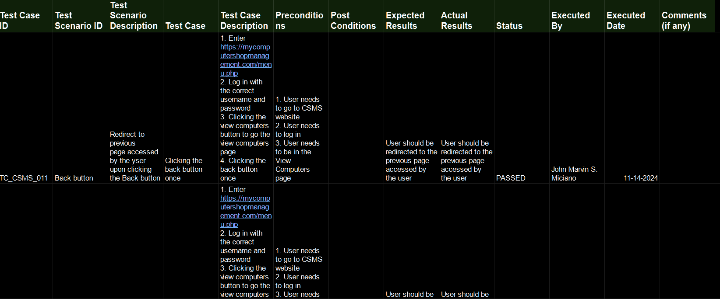
Functional Testing

Slide 9
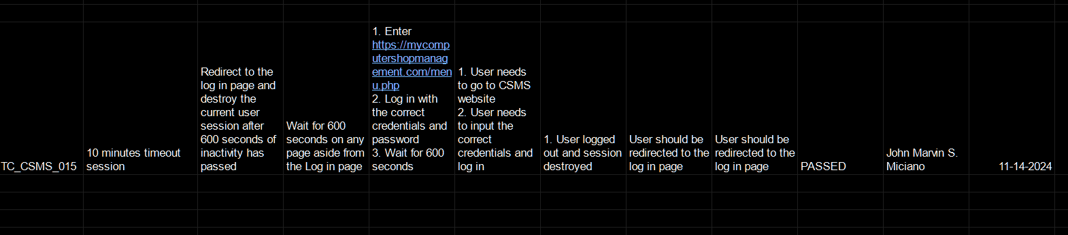
Security Testing

Slide 10
Risk and Mitigation
Security Risks : SQL injections and unauthorized access Mitigation : Prepared statements and session timeout
Data Loss : Risks of losing inventory data Mitigation : Regular database backups
System Downtime : Server downtime, network issues and electrical disruption Mitigation : Reliable hosting provider, contingency plan
Usability risks : Complexity in design Mitigation : Conduct user testing and gather feedback

Slide 11
Cost-Benefit Analysis (Cost Estimation)
Development Costs: Developer Time – Estimated at 8 hours at $5/hr = $40
Design and Wireframing – Estimated at 4 hours at $2.5/hr = $10
Hosting and Deployment Costs:
Domain Registration – $14/year
Premium Web Hosting – $4.39/month or $52.73/year SSL Certificate – free as it is included in the Domain Registration
Total Annual Costing = $66.73
Maintenance and Support:
Bug Fixes and Updates – Estimated at $5/hr Total estimated Cost (Initial Development + 1 year of hosting) = $116.73

Slide 12
Cost-Benefit Analysis (Annual Savings)
Assuming that the system will be used in the Philippines, an average cost of labor is $10.94 per day, at least 10 hours of labor is saved per month, thus the store has a monthly savings of $13.68 and an annual savings of $164.10

Slide 13
Cost-Benefit Analysis (ROI)
With the total annual savings of $164.10, the initial investment of $116.73 could be recouped in approximately 8 and a half months.

Slide 14
Cost-Benefit Analysis (Benefits)
Increased Efficiency – By using the system, store staff can manage inventory efficiently without manual inventory-keeping. This reduces the time spent on data entry and searching for the information, translating into cost savings on labor
Data Accuracy – Automated inventory management reduces human error, ensuring accurate stock levels, which can improve ordering decisions and reduces losses due to stockouts or overstocking.
Scalability – The system provides a scalable solution that can grow with the business accommodating additional staff and inventory without extra costs – Upon request, the system can be improve to include record keeping of customers

Slide 15
Conclusion
Summary: The system enhances inventory management through automation, security, and ease of use.
Future Enhancements and Improvements : Reporting and Analytics – Adding features for sales inventory reports would give the managers or the owner of the shop insights into trends, stock levels, and demand, helping in improving the shop Role-Based Access Control – Implementing roles for different user levels, for example admin, owner, staff, as to restrict access to certain functionalities Inventory Alerts – Implement a notification alert whenever the stock levels are low as to help staff manage inventory proactively Search and Filter – Implement search and filter as to make it easier for users to find specific records in the inventory

